Slide 1



StrokeCare AI
Golden Hour Stroke Lifesaver
Empowering Emergency Stroke Response with AI Call Center
Indonesia Healthcare AI Hackathon 2025
Team StrokeCareAI
Ariman – System Engineer, Simulation
AF. Nasution – Information Technology
TF. Pradatama – Research
RN. Afifuddin – System Information
Ns. Aghniya Cascara Ahmad – Medic
Get Well Again!
StrokeCareAI

Slide 2

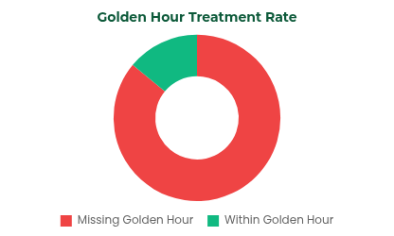

Problem Statement: Indonesia's Stroke Crisis
Stroke is the #1 leading cause of death in Indonesia (19.42% of all deaths)
Critical Gap
2.3 million stroke cases annually
Prevalence: 8.3 per 1,000 population (2023)
11.2% of total disabilities, 18.5% of deaths
Massive cost: BPJS IDR 5.2T (Top 3 highest)
Golden hour treatment is only achieved in 14-18% of cases
Early detection remains low (11.3% of 90% target)
Source: Ministry of Health Indonesia, 2023-2024
86% of patients miss the crucial golden hour window

Slide 3






Our Solution: StrokeCare AI Call Center
Real-time AI Voice Agent guides callers through FAST protocol
How It Works
24/7 voice access, no smartphone required
Automatic ambulance dispatch integrated with stroke-ready hospitals
Stroke Emergency Call
Any phone, any time
Technology stack:
AI Voice Assessment
Real-time FAST Protocol
Twilio Voice Gateway
Deepgram Voice Agent
STT+AI+TTS
FAST Protocol AI
Optimized for the 4.5-hour critical golden window – 'Time is Brain'
Ambulance Dispatch
To nearest stroke-ready hospital
Golden Hour Treatment
Life-saving intervention
Unique Value: First AI-powered stroke voice hotline in Indonesia with universal accessibility and real-time response

Slide 4


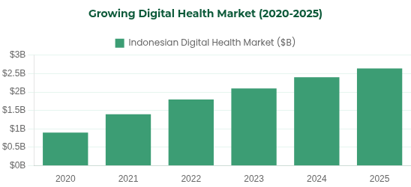
Market Opportunity & Target
Indonesian Stroke Market
Target Segments
2.3 million annual stroke cases in Indonesia
67% rise in young stroke cases in the last decade
Primary Target
Families with stroke history (2.3 million people)
Digital health market: $2.64B by 2025
90%
Stroke is the #1 cause of death in Indonesia
Secondary Target
Hypertension & diabetes patients at high risk
75%
Tertiary Target
General productive-age population (25-65 years)
60%
StrokeCare AI addresses all three segments with our voice-first approach, making critical care accessible regardless of technology literacy

Slide 5






Product Demo: StrokeCare AI in Action
Live Simulation of Stroke Emergency Call
Stroke Confirmation
Caller:
"My father suddenly has slurred speech and his face looks uneven. What should I do?"
Ambulance Dispatched
ETA: 7 minutes
StrokeCare AI:
Hospital Notification:
"I'll help assess your father using the FAST protocol. This could be a stroke - time is critical!
Nearest stroke-ready hospital has been notified of incoming stroke patient
Let me guide you through the assessment..."
While Waiting Guidelines:
FAST Protocol Assessment
Position patient on side
Loosen tight clothing
Face
Do not give food or drinks
"Ask him to smile - is his smile uneven?"
AI remains connected until ambulance arrives
Arms
"Ask him to raise both arms - does one drift downward?"
Speech
4.5h
Golden Hour Window
"Ask him to repeat a simple phrase - is speech slurred?"
Every minute saves 1.9 million brain cells
Time
"When did symptoms start? Every minute counts."
"His smile is crooked, left arm drifts down, and speech is slurred."
StrokeCare AI optimizes every second of the critical golden hour window

Slide 6


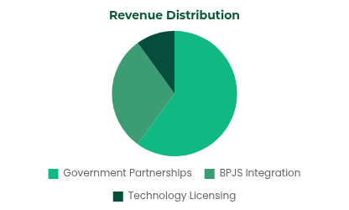



Business Model
Government Partnerships (60% Revenue)
Revenue Distribution
Kemenkes National License: IDR 10-20M per region
119 Integration: Stroke-specific routing protocol
Stroke-Ready Hospital Network: IDR 2-5M per hospital
BPJS Integration (30% Revenue)
Emergency call coverage: IDR 50K per stroke call
Golden hour bonus: Extra reimbursement for <4.5 hour treatment
Economic Advantages
Prevention program: Early detection incentives
Cost per call: IDR 2,000 (vs IDR 30,000 traditional)
Lives saved: 2,000+ annually
Healthcare cost reduction: IDR 1B annually
Technology Licensing (10% Revenue)
FAST Protocol AI: License to other countries
Training modules: Medical education institutions
Sustainable model with high societal impact + measurable cost savings

Slide 7




Competitive Landscape
Features
StrokeCare AI
FAST Rescue App
Traditional 119
Interface
Voice AI 24/7
Mobile App
Human Operators
Accessibility
Any phone
Smartphone only
Limited hours
Stroke Focus
100% specialized
Stroke-specific
General emergency
FAST Protocol
AI-guided real-time
Self-assessment
Not integrated
Response Time
0 seconds
User dependent
2-5 minutes
Language
Natural Indonesian
Text-based
Formal procedures
StrokeCare AI Competitive Advantages
First AI-powered stroke voice hotline in Indonesia
Real-time FAST protocol guidance
Breaking barriers to emergency access
Vs self-assessment with uncertain accuracy
Universal accessibility
Government integration ready
Any phone, any education level, nationwide
Designed for immediate national scale deployment

Slide 8







Meet the StrokeCareAI Team
Ariman
AF. Nasution
System Engineer, Simulation
Information Technology
Expert in healthcare system simulation and technical architecture design for medical emergency response systems.
Specialized in AI systems development with extensive experience in voice recognition technologies and emergency systems.
TF. Pradatama
RN. Afifuddin
Research
System Information
Data scientist focused on stroke pattern recognition and golden hour optimization research in Indonesian healthcare settings.
Expert in healthcare information systems integration with focus on emergency dispatch and hospital networks.
Ns. Aghniya Cascara Ahmad
Medic
Experienced medical professional specializing in emergency care and stroke protocol implementation. Provides critical medical expertise for the FAST Protocol AI development.
Advisory Support
Backed by leading advisors in neurology and health system management from Indonesia's top medical institutions and the Indonesian Stroke Society.
StrokeCareAI

Slide 9
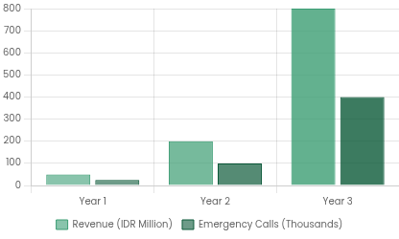


Financials & Impact
Year 1: IDR 50M revenue, 25,000 emergency calls
Revenue Growth Projection
Year 3: IDR 800M revenue, 400,000 calls, national scale
2,000+ lives saved per year with golden hour improvement
5,000+ disabilities prevented, IDR 1B in health cost reduction
40% increase in golden hour treatment rate (from 14% → 40%)
Life-Saving Impact
Every 100 calls to StrokeCare AI potentially saves 8 lives through faster treatment
Quality of Life Improvement
3-Year Sustainable Growth Model
20% reduction in post-stroke disability through golden hour optimization
14% → 40%
IDR 1B
Golden Hour Treatment Rate
Annual Healthcare Savings
StrokeCare AI: Financially sustainable with measurable health outcomes

Slide 10





Ask & Next Steps
Partnership Requests
Implementation Roadmap
Ministry of Health
National Stroke Program Integration
1
Week 1-2
Indonesian Stroke Society
FAST Protocol AI development & neurologist validation
Medical Protocol Validation
2
Week 3-4
119 Emergency Services
Pilot launch Jakarta (3 stroke-ready hospitals)
Stroke-specific Routing
Month 2
Stroke-Ready Hospitals
3
Scale to Java island (20 hospitals)
Direct Admission Pathway
4
Month 3-6
Funding Requirements
National rollout (100+ stroke-ready hospitals)
Development
IDR 40M
FAST AI Protocol & Voice Integration
Expected Outcomes
Year 1 Operations
IDR 200M
2,000+
lives saved in Year 1
40%
golden hour improvement
Infrastructure & Marketing
IDR 1B
healthcare savings
National
stroke response system
Total Investment
IDR 240M
For 25,000 stroke emergency calls
STROKECARE AI - EVERY SECOND COUNTS, SAVE LIVES NOW

Slide 11
References
Kementerian Kesehatan Republik Indonesia. (2023). Profil Kesehatan Indonesia 2023. https://kemkes.go.id/app_asset/file_content_download/172231123666a86244b83fd8.51637104.pdf
Kementerian Kesehatan Republik Indonesia. (2024). Survei Kesehatan Indonesia (SKI) 2023 — hasil & angka. https://www.badankebijakan.kemkes.go.id/hasil-ski-2023/
American Heart Association. (2019). Suggested Time Interval Goals for Stroke Treatment (Door-to-Needle etc.) [PDF]. https://www.heart.org/-/media/files/professional/quality-improvement/target-stroke/target-stroke-phase-iii/9-17-update/ds14860-time-interval-one-pager_v2.pdf
Khandelwal, A., Sarma, K., Hussain, M., Dikshit, P., & Baidya, D. (2025). Acute ischemic stroke and the golden hour: Critical updates. Journal of Neurosciences in Rural Practice. https://ruralneuropractice.com/acute-ischemic-stroke-and-the-golden-hour-critical-updates/
"Door to needle time 25 minutes thrombolysis therapy in acute ischemic stroke." Journal of Neurosurgery. https://www.jns-journal.com/article/S0022-510X%2819%2930999-2/fulltext
Advisory Support
Backed by leading advisors in neurology and health system management from Indonesia's top medical institutions and the Indonesian Stroke Society.
StrokeCareAI

